Slide 1
EAP3 – Week 6
Single and multi word verbs
Hedging
Linking words of comparison and contrast

Slide 2
Answers
How reliable are the local weather forecasts?
Details of the accident are scarce.
This voyage marked an important milestone in the history of exploration.
We did not realize the magnitude of the problem.
The prime minister rejected any idea of reforming the system.
He was a politician who embodied the hopes of black youth.
He was intensely aware of his own vulnerability.
I was astonished by the size and complexity of the problem.
There's not much sustenance in a bowl of soup.
We had relatively few applications for the job.
I'll leave you in Robin's capable hands—metaphorically speaking, of course!

Slide 3
1 come up a. arise
2 come up against b. experience
3 cut out c. remove
4 find out d. discover
5 go together e. coincide
6 look into f. investigate
7 put off g. delay
8 start off h. begin
9 think about i. consider
10 work out j. calculate

Slide 4
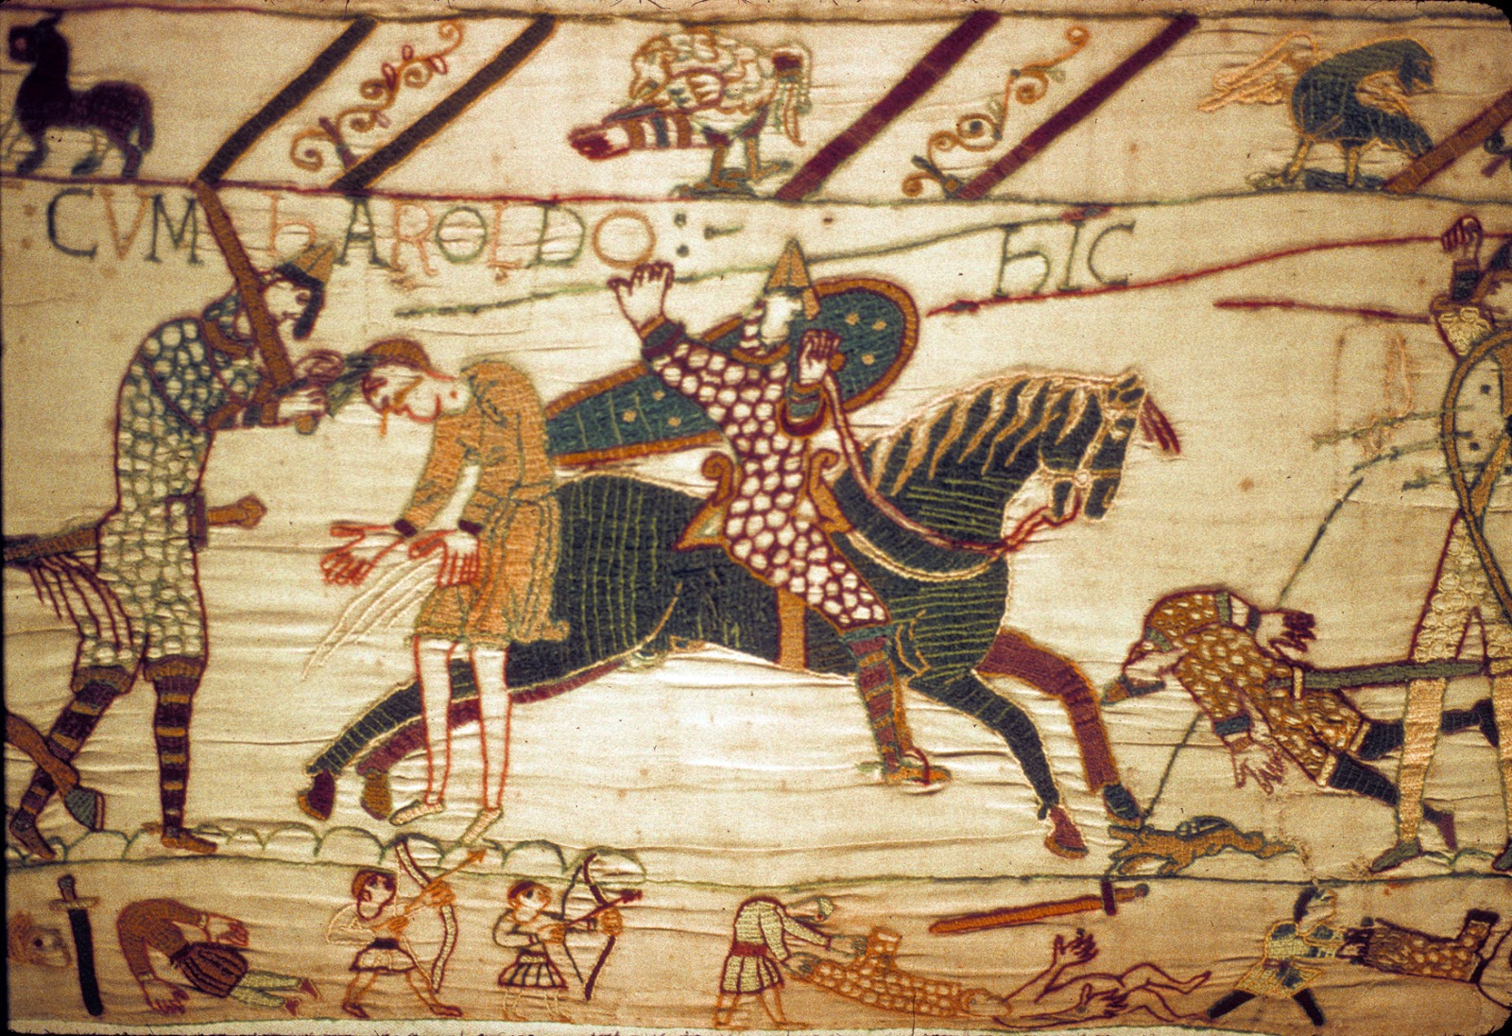

Slide 5
Single and Multi Word Verbs
Single word verbs in are preferred in academic writing because they are more formal.
Key exercise 5.5, p. 74
2 looking at: observe
3 put across: communicate
4 come across: encounter
5 join up: combine; send out: transmit
6 come about: occurred
7 put together: created
8 lay out: display

Slide 6
Hedging
Hedging is an important process in academic communication in order to:
avoid making statements that ere too direct or too confident
be able to talk about theories and possibilities rather than facts
We use hedges to indicate that something may be true, is partially true, or true in some cases , and so on.

Slide 7
When to use hedges?
Checklist questions:
Can there be any exceptions to this statement?
Is there evidence or data which demonstrates fully that this is true?
Is any of the language in the statement ambiguous and in need of clarification?
Is the answer ‘yes’? → then likely a hedge is needed

Slide 8
Hedging: exercise
In pairs, decide which claims should be hedged. More than one answer is possible.
Air pollution is not a new phenomenon.
Half of the Earth’s species will disappear in the next 75 years.
Evidence proves that there is a clear human influence on global climate.
By far the worst concentrations of pollutants are found in urban areas.
Climate change is the most important danger currently facing humanity.
Eventually it will no longer be profitable to use oil as the primary fuel for the world.
Air pollution has got worse in developing countries because of economic growth.

Slide 9
Hedging: exercise KEY
Air pollution is not a new phenomenon. No hedge needed.
Half of the Earth’s species may disappear in the next 75 years.
Evidence appears to show/ suggests that there is a clear human influence on global climate.
By far the worst concentrations of pollutants are found in urban areas. No hedge needed.
Climate change is perhaps the most important danger currently facing humanity.
Eventually it will no longer be profitable to use oil as the primary fuel for the world. No hedge needed.
Air pollution has got worse in developing countries mainly because of economic growth.

Slide 10
Linking words: comparison and contrast
Biology - Chemistry
Both biology and chemistry are examples of science subjects.
While biology focuses on the study of living things, chemistry concentrates on living things.

Slide 11
Linking words of comparison and contrast: 1
Sentence-sentence linking expressions, e.g. however, therefore:
I tried to submit my thesis on time. However, I didn’t meet the deadline.
Clause-clause linkers, e.g. but, although:
Although I failed to submit my thesis on time, I received a high grade for it.

Slide 12
Linking words of comparison and contrast: 2
Linking words of comparison and contrast are often preceded by words or phrases that demonstrate the degree of similarity or difference, such as no, far, considerably, much, rather, significantly, slightly, substantially, somewhat
Chemistry is considered to be significantly more difficult than Biology.

Slide 13
Linking words of comparison and contrast: 3
Parallelism is a useful strategy for showing similarities of differences in a subtle, understated manner. This kind of ‘echo’ effect can create links in the reader’s mind implicitly
While biology focuses on the study of living things, chemistry concentrates on living things.

Slide 14
More … than: collocations
Most commonly used adjectives with the structure more … than:

Slide 15
More … than: collocations
Most commonly used adjectives with the structure more … than:
Important
Likely
Complex
Effective
Efficient

Slide 16
Less … than: collocations
Most commonly used adjectives in structure: less … than?

Slide 17
Less … than: collocations
Most commonly used adjectives in structure: less … than?
Important
Likely
Effective
Common
Efficient

Slide 18
KEY ex. 11.2, p. 62
2) A soldier is a member of a country’s armed forces, whereas a mercenary is a hired soldier for service in a foreign army.
3) In the U.S., the terms ‘college’ and ‘university’ are interchangeable. However, in the UK, ‘college’ is usually an institution between school and university.
4) In a constitutional monarchy, the monarch is the head of state but legally bound by the constitution; in an absolute monarchy, the monarch is the sole source of political power but not legally bound by the constition.
5) Health education programmes in schools can contribute towards the development of a responsible attitude towards diet. Similarly, publicity campaigns and advertising can spread knowledge about diet.

Slide 19
Homework
Mid Term Test:
Study Word Lists 1-5
and Grammar &Vocabulary 1-5

